Slide 1
DATA SCIENCE
10 WEEK PART TIME COURSE
Week 1c – Our Git Workflow

Slide 2
AGENDA
Yet more Git
Git Lab

Slide 3

A BIT MORE GIT!
DATA SCIENCE PART TIME COURSE

Slide 4
GIT Workflows
Workflow | Features | Ideal Use Case
Centralised | One repo One branch | Your course project Tiny teams
Feature Branch | One repo Many branches | Typical environment
Forking Workflow | Many repos | Homework Bureaucratic / Formal

Slide 5
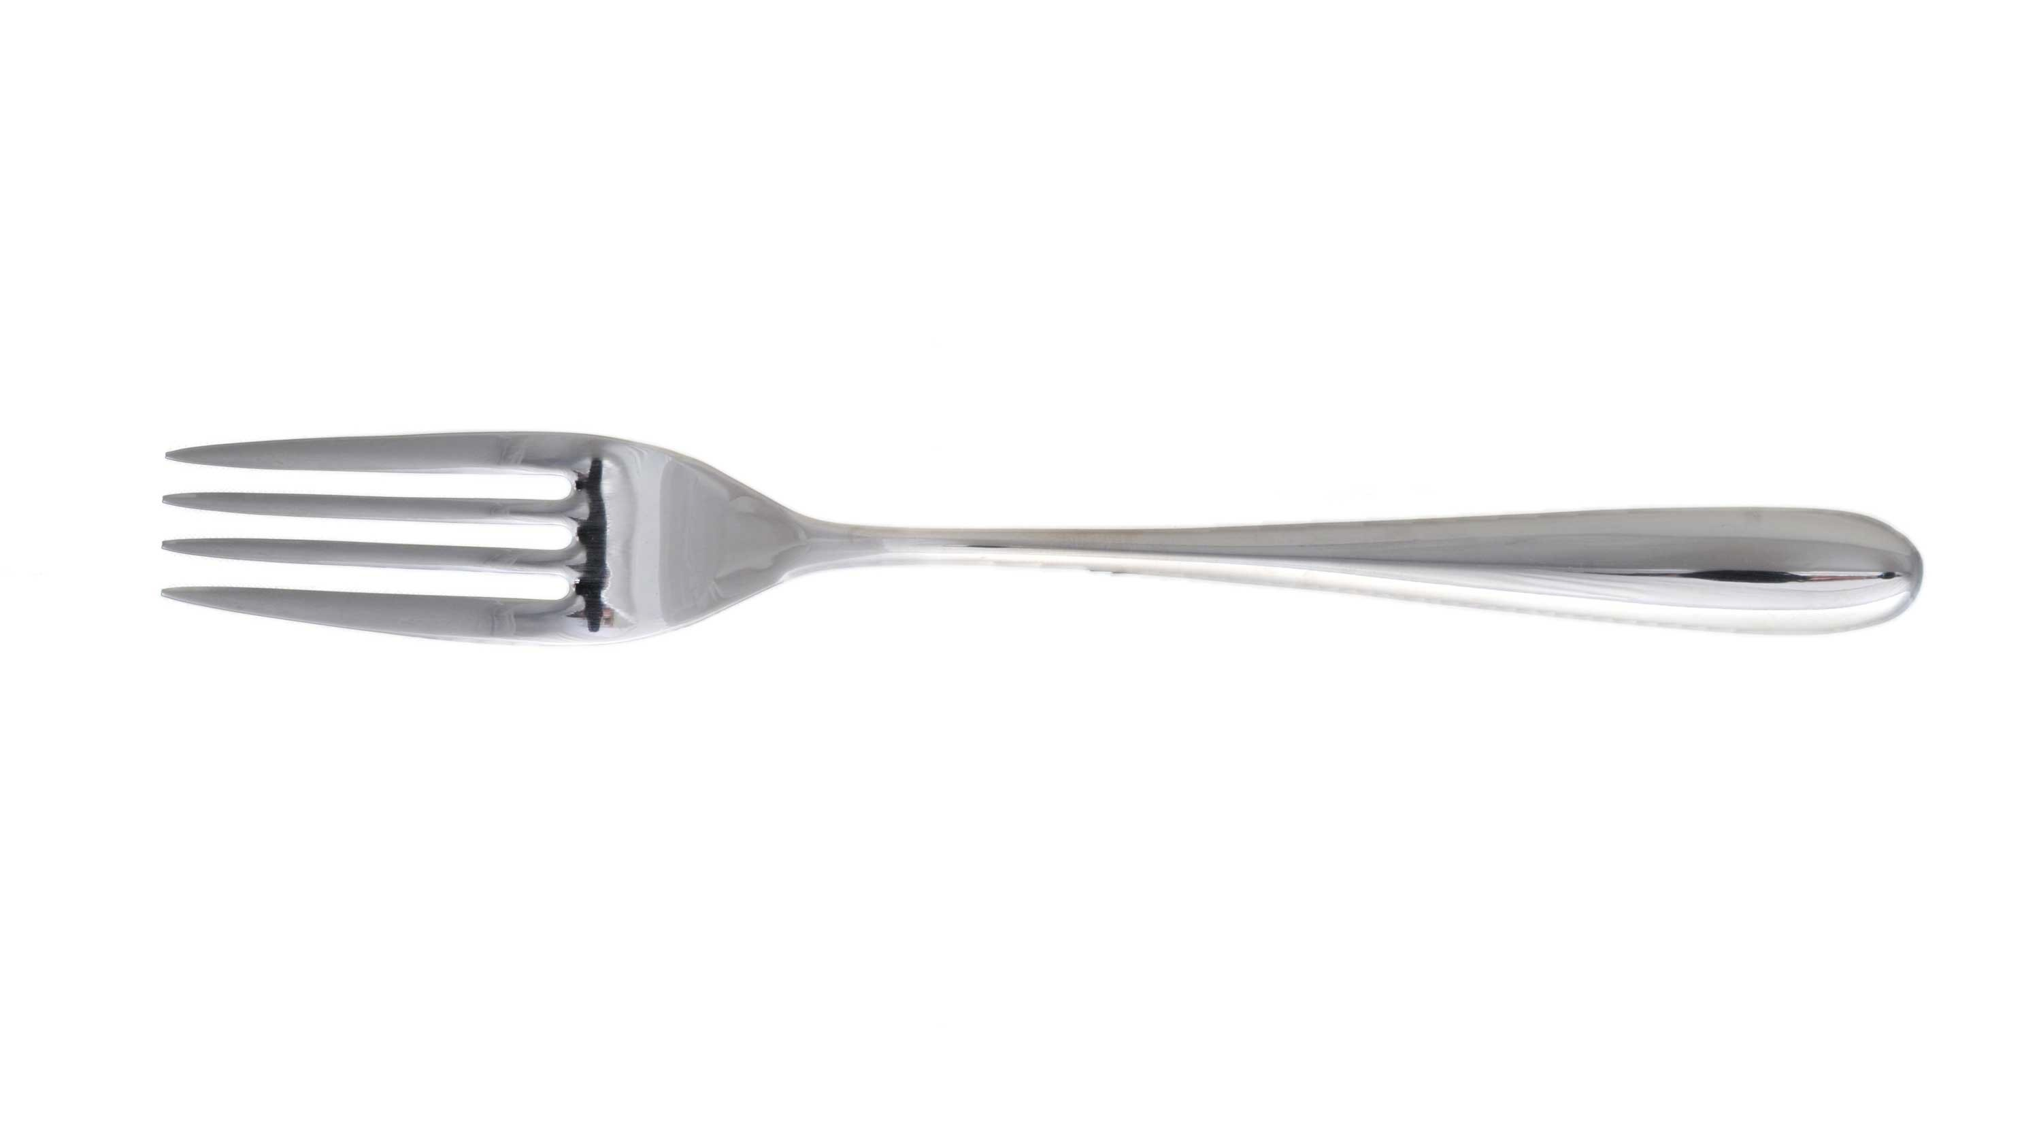
FORKING WORKFLOW
Forking, making a copy of someone else’s repository so you can work on it

Slide 6
FORKING WORKFLOW
Course Repo
github.com/coolstudent/course
Course Repo
github.com/solresol/SYD_DAT_5
1. Fork
6. Pull Request
2. Clone
5. Push
CoolStudent Laptop
3. Update a file
4. Commit

Slide 7
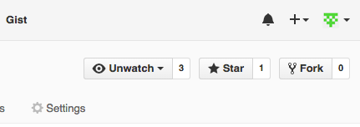
FORKING WORKFLOW
Course Repo
github.com/coolstudent/course
1. Fork
Course Repo
github.com/solresol/SYD_DAT_5
6. Pull Request
2. Clone
5. Push
CoolStudent Laptop
Forking, making a copy of someone else’s repository so you can work on it
3. Update a file
4. Commit

Slide 8
FORKING WORKFLOW
Course Repo
github.com/coolstudent/course
Course Repo
github.com/solresol/SYD_DAT_5
1. Fork
6. Pull Request
2. Clone
5. Push
CoolStudent Laptop
Cloning is copying the repo to your local machine (like Monday’s class)
3. Update a file
4. Commit

Slide 9
FORKING WORKFLOW
Course Repo
github.com/coolstudent/course
Course Repo
github.com/solresol/SYD_DAT_5
1. Fork
6. Pull Request
2. Clone
5. Push
CoolStudent Laptop
Update files and commit any changes you make (still only on your local machine)
3. Update a file
4. Commit

Slide 10
FORKING WORKFLOW
Course Repo
github.com/coolstudent/course
Course Repo
github.com/solresol/SYD_DAT_5
1. Fork
6. Pull Request
2. Clone
5. Push
CoolStudent Laptop
Push the changes from your local machine to your github account
3. Update a file
4. Commit

Slide 11
FORKING WORKFLOW
Course Repo
github.com/coolstudent/course
Course Repo
github.com/solresol/SYD_DAT_5
1. Fork
6. Pull Request
2. Clone
5. Push
CoolStudent Laptop
Then submit those changes as a pull request so I can see them.
3. Update a file
4. Commit

Slide 12
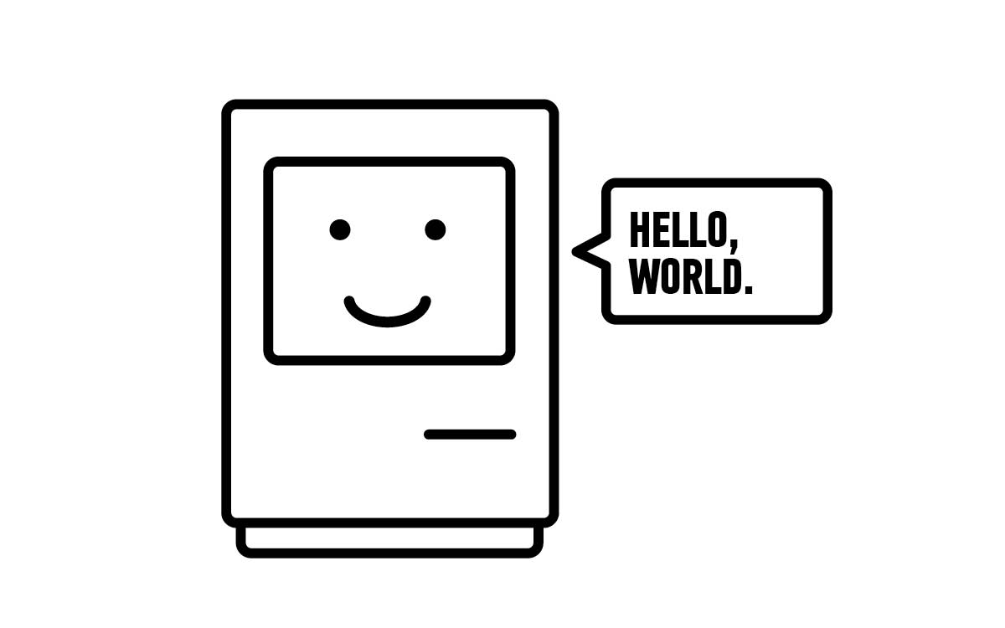
GIT LAB
DATA SCIENCE PART TIME COURSE
Fork the course repository
Clone
Make a folder under Week 1/labs, and put a file in it.
Add, commit, push
Make a pull request for me

Slide 13
DISCUSSION TIME
DATA SCIENCE - Week 1 Day 2

Slide 14
Readings
Data Science Handbook
DATA SCIENCE - Week 1 Day 2

Slide 15
DISCUSSION TIME
Homework
Due next Friday
I will review within 7 days
Counts to letter of completion
(Will be easy)
DATA SCIENCE - Week 1 Day 2

